Slide 1


Vocabulary

Slide 2

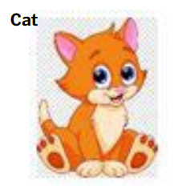
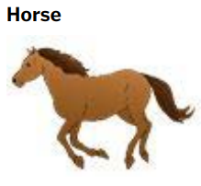
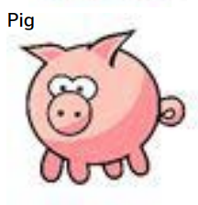
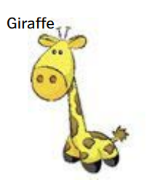
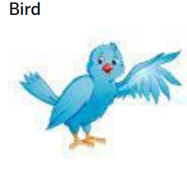
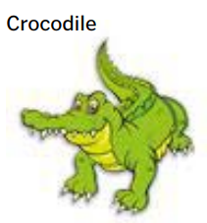
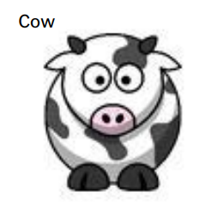
Vocabulary
Colors
Animals
White
Black
Blue
Orange
Purple
Gray
Yellow
Red
Pink
Green
Brown

Slide 3
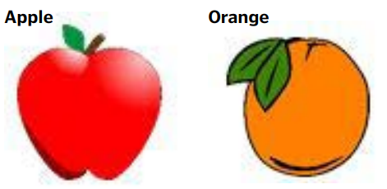
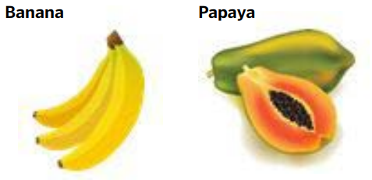
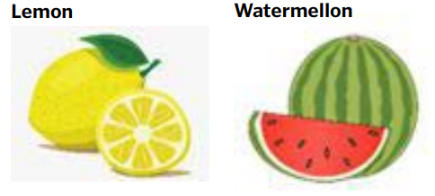

Vocabulary
Fruits
Days of the week
DAYS OF THE WEEK
Sunday | Domingo
Monday | Segunda-Feira
Tuesday | Terça-Feira
Wednesday | Quarta-Feira
Thursday | Quinta-Feira
Friday | Sexta-Feira
Saturday | Sabado

Slide 4
Vocabulary
Months of the year
January July
February August
March September
April October
May November
June December
Numbers
Cardinal Numbers, indica o número ou quantidade dos elementos de um conjunto.
CARDINAL NUMBER CHART
17 – Seventeen
18 – Eighteen
19 – Nineteen
20 - Twenty
21 – Twenty-one
22 – Twenty-two
23 – Twenty-three
24 – Twenty-four
25 – Twenty-five
26 – Twenty-six
27 – Twenty-seven
28 – Twenty-eight
29 – Twenty-nine
30 - Thirty
31 – Thirty-one
32 – Thirty-two
33 – Thirty-three
34 – Thirty-four
35 – Thirty-five
36 - Thirty-six
37 – Thirty-seven
38 – Thirty-eight
39 – Thirty-nine
40 – Forty
41 – Forty-one
42 – Forty-two
43 – Forty-three
44 – Forty-four
45 – Forty-five
46 – Forty-six
47 – Forty-seven
48 – Forty-eight
49 – Forty-nine
50 – Fifty
51 – Fifty-one
52 – Fifty-two
53 – Fifty-three
54 – Fifty-four
55 – Fifty-five
56 – Fifty-six
01 – One
02 – Two
03 – Three
04 – Four
05 – Five
06 – Six
07 – Seven
08 – Eight
09 – Nine
10 – Ten
11 – Eleven
12 – Twelve
13 – Thirteen
14 – Fourteen
15 – Fifteen
16 – Sixteen

Slide 5
Vocabulary
57 – Fifty-seven
58 – Fifty-eight
59 – Fifty-nine
60 – Sixty
70 – Seventy
80 – Eighty
90 – Ninety
100 – One hundred
105 – One hundred and five
174 – one hundred and seventy-four
1,000 – One Thousand
1,000,000 – One million
1,000,000,000 – One billion
17th – Seventeenth
18th – eighteenth
19th – Nineteenth
20th – Twentieth
21st – Twenty-first
22nd – Twenty-second
23rd – Twenty-third
24th – Twenty-fourth
25th – Twenty-fifth
26th – Twenty-sixth
27th – Twenty-seventh
28th – Twenty-eighth
29th – Twenty-ninth
30th – Thirtieth
31st – Thirty-first
40th – Fortieth
50th – Fiftieth
60th – Sixtieth
70th – Seventieth
80th – Eightieth
90th – Ninetieth
100th – One hundredth
1,000th – One thousandth
1,000,000th – One
millionth
Ordinal Numbers, introduz ordem e dá ideia de hierarquia: Primeiro, segundo, terceiro, etc.
ORDINAL NUMBER CHART
1st – First
2nd – Second
3rd – Third
4th – fourth
5th – Fifth
6th – Sixth
7th – Seventh
8th – Eighth
9th – Ninth
10th – Tenth
11th – Eleventh
12th – Twelfth
13th – Thirteenth
14th – Fourteenth
15th – Fifteenth
16th – Sixteenth

